Slide 1
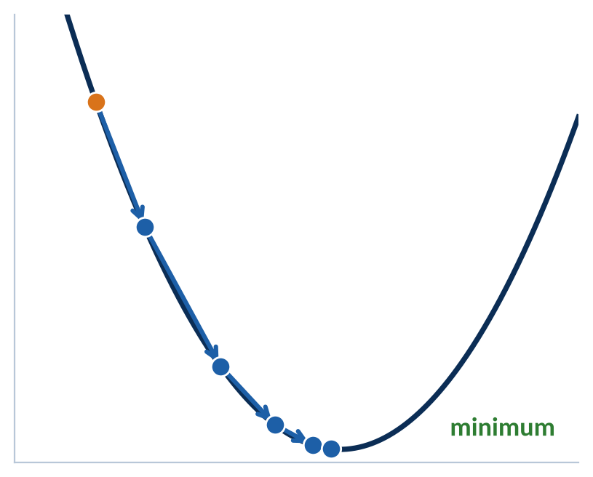

CompSci 471
Artificial Intelligence
Lesson 29: Neural Networks II
Measure the miss. Assign the blame. Nudge every weight.
Forward
Loss
Backward
Update
Training is a walk downhill on the loss.
Fall 2026
Notes:
TIMING: 1 min (slides 1-3 total 4 min).
INSTRUCTOR: The curve shows how wrong a network is (its loss) for every possible value of one weight. Training starts somewhere random (orange dot) and takes repeated steps downhill toward the minimum. Every step is the same four-part loop shown on the left: run the network forward, measure the miss (loss), assign blame to every weight (backward pass), and update each weight. By slide 9 students will compute these exact steps by hand.
CENTRAL CLAIM: A network learns by repeating one loop: measure the miss, assign blame to every weight with backpropagation, and nudge each weight downhill with gradient descent. The goal is low validation loss, not zero training loss; training curves show whether the loop is working, and regularization stops the network from memorizing.
ASSESSMENT ALIGNMENT: Framing only. [Confirm lesson placement and assessment timing against the syllabus when available.]

Slide 2
Retrieval: where do the weights come from?
L28 handed us every weight. Today the network finds its own.
L28 | Forward pass
L26 | Generalization
L27 | Smoothing α
Every weight and bias was given to us.
Memorizing training data fails on new data.
A knob that traded variance for bias.
Where did they come from?
Watch the train/test gap.
Today: a new knob, λ.
How does a network find thousands of weights by itself?
Turn and talk (45 s): why not just try random weights until one works?
CS 471 | L29: Neural Networks II
2
Notes:
TIMING: 1.5 min.
INSTRUCTOR: Three callbacks. (1) L28: every weight and bias in the forward-propagation examples was given to us, as if by magic. Today is where they come from. (2) L26: a model that memorizes its training data scores well there and fails on new data; train/test gaps were our diagnostic. Neural networks are the most powerful memorizers we have met, so this matters more than ever. (3) L27: the smoothing strength alpha was a knob; too much flattened the model into high bias. Today's regularization strength lambda is the same kind of knob.
Turn-and-talk answers: trial and error would take forever with thousands of weights; we need a systematic rule that says which way to move each weight.
ASSESSMENT ALIGNMENT: Retrieval for Objectives 1 and 3. [Confirm against GR/quiz items when available.]

Slide 3
Today’s mission
By the end of Lesson 29, you should be able to…
1
Compute an MSE loss and a gradient-descent weight update, and explain how backpropagation assigns blame through the chain rule.
2
Interpret training curves to diagnose underfitting, overfitting, a good fit, and learning-rate problems.
3
Mitigate overfitting with L2 regularization, dropout, and early stopping, and explain why each works.
Performance target: given a gradient and a learning rate, compute the weight update; then read a training curve, diagnose it, and prescribe a fix.
CS 471 | L29: Neural Networks II
3
Notes:
TIMING: 1.5 min.
INSTRUCTOR: Objective 1 = Parts 1 and 2 (loss, gradient descent, backpropagation). Objective 2 = Part 3 (training curves). Objective 3 = Part 4 (regularization). Point to the performance target: students do the update on slide 10, the diagnosis on slide 17, and both on the exit ticket.
DESIGN NOTE: The source listed L2 among the regularization techniques but never covered it; slide 19 adds it.
ASSESSMENT ALIGNMENT: Knowledge Check Q1 (learning rate too high) = Objective 1 and 2; Q2 (train 0.01 vs. validation 4.50) = Objective 2 and 3; Q3 (dropout mechanism) = Objective 3. [Map to specific GR, quiz, Blackboard homework, and notebook items when available.]

Slide 4
Running scenario: train the ETA predictor
Last lesson’s ride-share model, shrunk to one weight so we can watch it learn.
Trip | Distance x (km) | Actual ETA y (min)
1 | 2 | 6
2 | 4 | 12
3 | 5 | 15
1 Forward
Run the model: predict each ETA.
2 Loss
Measure how badly the predictions missed.
Model: predicted ETA = w × distance
3 Backward
Work out how much each weight is to blame.
Start: w = 1 (a random guess)
4 Update
Nudge each weight to shrink the miss. Repeat.
Forward
Loss
Backward
Update
CS 471 | L29: Neural Networks II
4
Notes:
TIMING: 2 min (Part 1 total 16 min).
INSTRUCTOR: In L28 the ride-share network predicted ETA from shared hidden features, with every weight given. Today we strip it down to a single weight so every number fits on a slide: ETA = w x distance. Three past trips are the training data. The true pattern is 3 minutes per km (students may spot it), but the model does not know that; it starts from a random guess, w = 1.
Introduce the loop bar at the bottom of the slide. It stays on screen through slide 13 with the current step highlighted. Real networks run exactly this loop, just with millions of weights at once.
ASSESSMENT ALIGNMENT: Context for Objective 1. Original numbers. [Confirm against GR/quiz items when available.]

Slide 5
Loss: measure the miss
Mean squared error turns all the misses into one number to shrink.
L = (1/N) Σ (y_{i} − ŷ_{i})²
Trip | x | y | ŷ = 1 × x | Error y − ŷ | Error²
1 | 2 | 6 | 2 | 4 | 16
2 | 4 | 12 | 4 | 8 | 64
3 | 5 | 15 | 5 | 10 | 100
Why square the errors?
Misses in opposite directions can’t cancel out.
Big misses cost much more: 10² = 100, but 4² = 16.
MSE = (16 + 64 + 100) / 3 = 60
Forward
Loss
Backward
Update
CS 471 | L29: Neural Networks II
5
Notes:
TIMING: 2.5 min.
INSTRUCTOR: Forward pass with w = 1: predictions 2, 4, 5 minutes. Errors (actual minus predicted): 4, 8, 10. Squared: 16, 64, 100. Mean: 180 / 3 = 60. That single number is the loss; training means making it smaller.
Why square? (1) A miss of +5 and a miss of -5 would cancel to 0 if we just averaged errors, hiding two bad predictions. (2) Squaring punishes big misses much more than small ones: a 10-minute miss costs 100, a 4-minute miss costs 16.
Correct the reading: the goal is not literally to drive training loss to zero (we will see in Part 3 that zero training loss usually means memorizing). The goal is low loss on data the model has not seen.
ASSESSMENT ALIGNMENT: Objective 1 (compute MSE). Original numbers. [Confirm against GR/quiz/homework items when available.]

Slide 6
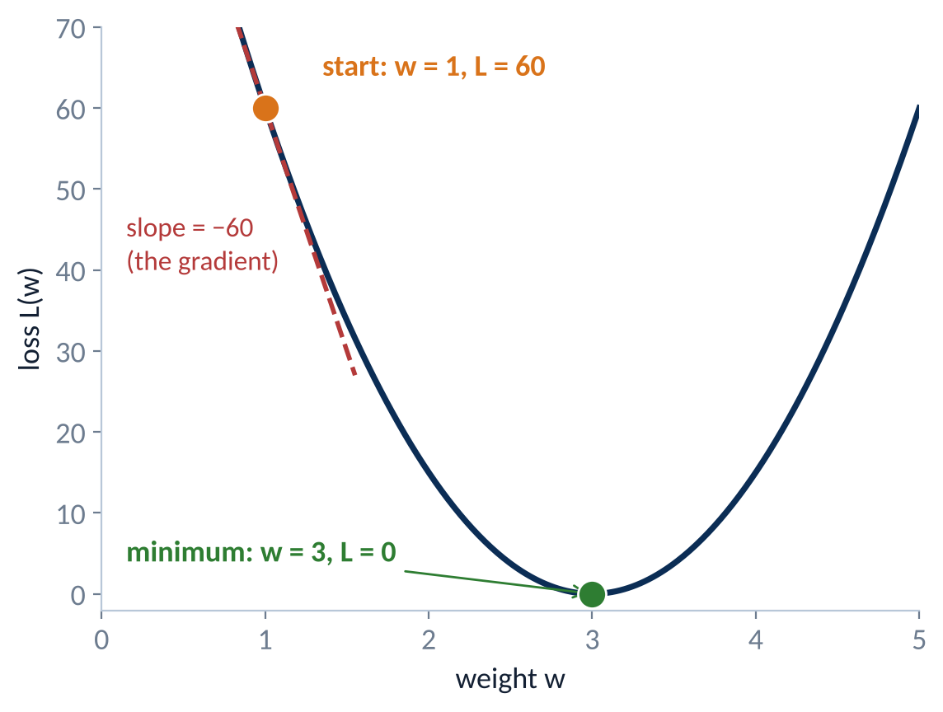
The loss landscape
Every possible weight has a loss. Training walks downhill.
Where we are
w = 1, loss = 60. A random start.
Where we want to be
The bottom of the bowl: w = 3, loss = 0.
The gradient
The slope under our feet: −60. Its sign says which way is uphill; its size says how steep.
Real networks: one dimension per weight. We can’t see the valley, but we can always feel the slope.
Forward
Loss
Backward
Update
CS 471 | L29: Neural Networks II
6
Notes:
TIMING: 2 min.
INSTRUCTOR: For this tiny model we can compute the loss for every possible w: it works out to L(w) = 15(w - 3)^2, a parabola (derivation in backup B1). Our random start sits at w = 1 with loss 60. The bottom of the bowl, w = 3, gives loss 0: 3 minutes per km.
The red dashed line is the slope of the curve right under our feet: -60. That slope is the GRADIENT. Its sign says which way is uphill (negative slope: uphill is to the left), and its size says how steep it is.
In a real network the "landscape" has one dimension per weight (millions), so nobody can draw it or see the bottom. But the gradient can still be computed at the current spot, and that is all gradient descent needs.
ANALOGY (from the reading): hiking down a mountain at night, blindfolded. You cannot see the valley, but you can feel the slope under your boots.
ASSESSMENT ALIGNMENT: Objective 1 (meaning of the gradient). [Confirm against GR/quiz items when available.]

Slide 7
The update rule
Step against the slope, scaled by the learning rate.
w_{new} = w_{old} − α × ∂L/∂w
∂L/∂w (the gradient)
Minus sign
α (learning rate)
Slope of the loss for this weight. Points uphill, toward more error.
Step the opposite way: downhill.
Stride length. How far to step each time.
Gradient positive → w decreases
Increasing w would add error, so back off.
Gradient negative → w increases
Our start: ∂L/∂w = −60, so w should go up.
Forward
Loss
Backward
Update
CS 471 | L29: Neural Networks II
7
Notes:
TIMING: 2 min.
INSTRUCTOR: The gradient points uphill, toward MORE error. So we step the opposite way, which is why the rule SUBTRACTS the gradient. Alpha (the learning rate) scales the step.
Sign logic, the thing students get wrong: positive gradient (increasing w raises the loss) means w goes DOWN. Negative gradient (increasing w lowers the loss) means w goes UP. Our start has gradient -60, so w should increase, which matches the picture (minimum is to the right).
Analogy: a blindfolded hiker feels the ground slope up to the left, so steps right. Alpha is stride length.
ASSESSMENT ALIGNMENT: Objective 1 (gradient descent update rule); Knowledge Check Q1 setup. [Confirm against GR/quiz items when available.]

Slide 8
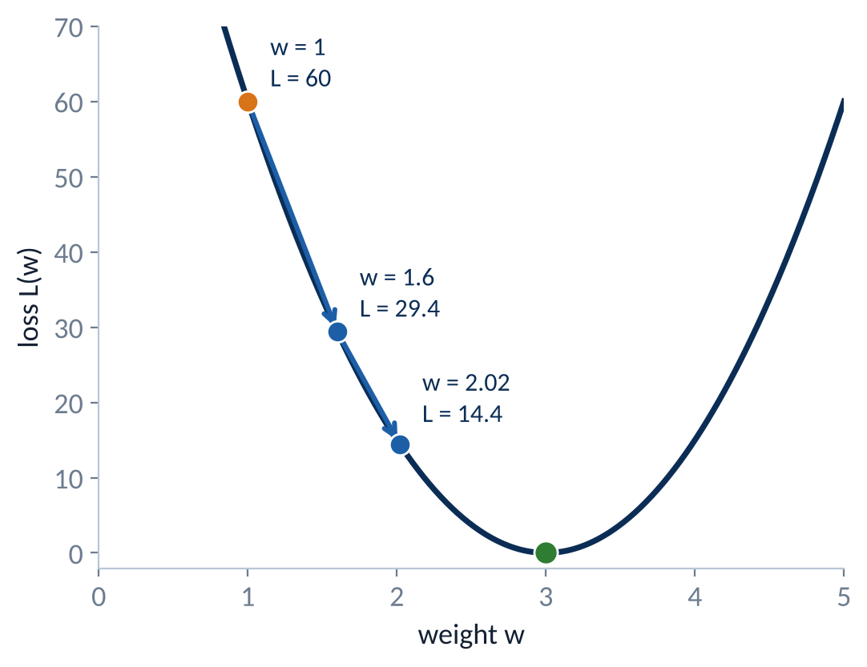
Worked example: one update
Compute → Interpret → Predict, starting from w = 1 with α = 0.01.
Gradient for this model: ∂L/∂w = 30(w − 3)
Compute
∂L/∂w = 30(1 − 3) = −60
w = 1 − 0.01(−60) = 1.6
New loss = 15(1.6 − 3)² = 29.4
Interpret
The negative gradient said “increase w.” One step cut the loss from 60 to 29.4.
Predict
Take the next step from w = 1.6. Where does w land, and is the step bigger or smaller?
Forward
Loss
Backward
Update
CS 471 | L29: Neural Networks II
8
Notes:
TIMING: 3 min.
INSTRUCTOR: For this model, calculus gives the gradient formula dL/dw = 30(w - 3) (derived in backup B1; students do not need to derive it today, only use it).
COMPUTE: At w = 1: 30(1 - 3) = -60. Update: w = 1 - 0.01(-60) = 1 + 0.6 = 1.6. New loss: 15(1.6 - 3)^2 = 15(1.96) = 29.4, roughly half of 60.
INTERPRET: The negative gradient told us to increase w, and one step cut the loss in half. The predictions are now 3.2, 6.4, 8: still short, but closer.
PREDICT: Next step. Gradient at 1.6 = 30(-1.4) = -42. w = 1.6 + 0.42 = 2.02. Loss = 15(0.98)^2, about 14.4. Notice the steps shrink as the slope flattens near the bottom: gradient descent automatically slows down as it arrives.
WATCH FOR: Students subtracting a negative incorrectly (writing 1 - 0.6 = 0.4).
ASSESSMENT ALIGNMENT: Objective 1 (compute a gradient-descent update). Original numbers. [Confirm against GR/quiz/homework items when available.]

Slide 9
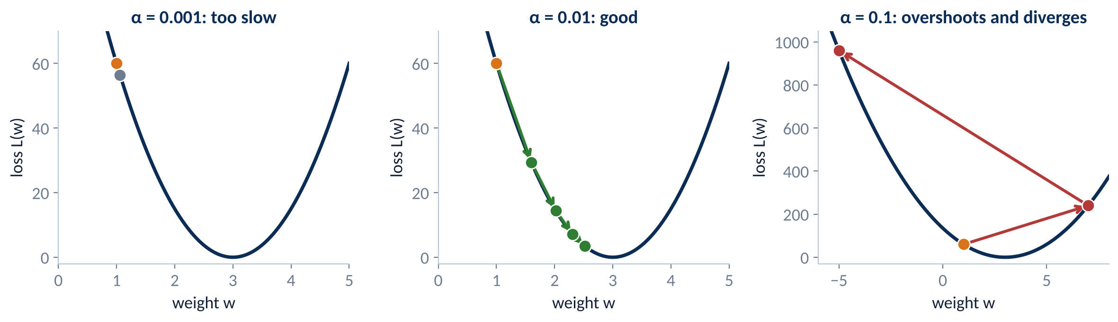
The learning rate decides the step
Same start, same gradient, three very different outcomes.
α | Step = α × 60 | New w | New loss | Verdict
0.001 | 0.06 | 1.06 | ≈ 56 | Too slow
0.01 | 0.6 | 1.6 | 29.4 | Good
0.1 | 6 | 7 | 240 | Overshoot, then diverge
Forward
Loss
Backward
Update
CS 471 | L29: Neural Networks II
9
Notes:
TIMING: 3 min.
INSTRUCTOR: All three start at w = 1 with gradient -60. Only alpha changes.
alpha = 0.001: w = 1 + 0.06 = 1.06; loss about 56. Correct direction, but it would take hundreds of steps to arrive.
alpha = 0.01: w = 1.6; loss 29.4. Steady progress (as on slide 8).
alpha = 0.1: w = 1 + 6 = 7. It jumped right over the valley; loss 15(4)^2 = 240, four times WORSE than the start.
PREDICT (right panel): from w = 7 the gradient is 30(4) = +120, so w = 7 - 12 = -5, loss 960. Each step overshoots further: training diverges and the loss explodes.
Knowledge Check Q1: too high a learning rate makes updates overshoot; the loss bounces or grows instead of shrinking.
SIMULATOR: Use the course's interactive learning-rate simulator here if time allows.
ASSESSMENT ALIGNMENT: Objectives 1-2; Knowledge Check Q1. Original numbers. [Confirm against GR/quiz items when available.]

Slide 10
Practice: satellite attitude controller
Pairs, 2 minutes. Apply the update rule to two weights.
(a)
w = 0.8
α = 0.05
∂L/∂w = −4
(b)
w = 1.2
α = 0.05
∂L/∂w = +6
w_{new} = ?
w_{new} = ?
For each weight: did it go up or down, and how could you have predicted that from the sign of the gradient alone?
Forward
Loss
Backward
Update
CS 471 | L29: Neural Networks II
10
Notes:
TIMING: 2 min (pairs). If short on time, assign as homework.
ANSWERS (do not show until pairs finish):
(a) w = 0.8 - 0.05(-4) = 0.8 + 0.2 = 1.0. Negative gradient, so the weight increased.
(b) w = 1.2 - 0.05(6) = 1.2 - 0.3 = 0.9. Positive gradient, so the weight decreased.
Follow-up: "If alpha were 0.5, what would (b) become?" 1.2 - 3 = -1.8: a huge jump, a sign that alpha may be too large.
CONTEXT: A network that keeps a satellite pointed at a ground station adjusts reaction-wheel commands; these are two of its weights during training.
ASSESSMENT ALIGNMENT: Objective 1 (independent practice: weight update). Original numbers. [Confirm against GR/quiz/homework items when available.]

Slide 11
Backpropagation: blame flows backward
The chain rule multiplies local effects from the loss back to each weight.
input
x
× w₁
hidden
h
× w₂
output
ŷ
(y − ŷ)²
loss
L
forward →
← blame
∂L/∂h = ∂L/∂ŷ × w₂
∂L/∂ŷ
start here
∂L/∂w₁ = ∂L/∂h × x
∂L/∂w₂ = ∂L/∂ŷ × h
Chain rule
One pass, every weight
A weight deep in the network affects the loss through every later layer, so its blame is the product of the local effects along that path.
A single backward sweep gives every gradient, reusing shared pieces like ∂L/∂h. Then gradient descent updates them all.
Forward
Loss
Backward
Update
CS 471 | L29: Neural Networks II
11
Notes:
TIMING: 2.5 min (Part 2 total 8 min).
INSTRUCTOR: With one weight, the gradient came from one formula. A real network has weights buried several layers deep. How much is a first-layer weight to blame for the final miss? Its effect travels through every later layer, so we multiply the local effects along the path: that is the chain rule.
Walk the diagram. Forward (blue): x times w1 gives h, h times w2 gives y-hat, and comparing y-hat to the target gives the loss. Backward (orange): start at the loss, compute how the loss changes with y-hat, then pass that blame back through each connection by multiplying by the local effect. The weight-gradient boxes at the bottom are what gradient descent needs.
Key efficiency point: one backward pass delivers the gradient for EVERY weight at once, reusing shared pieces (dL/dh is computed once and reused). That is why training large networks is feasible.
ANALOGY (from the reading): an artillery battery that missed works backward from the impact point to decide which dial (elevation, windage, charge) contributed most to the miss.
ASSESSMENT ALIGNMENT: Objective 1 (explain backpropagation). [Confirm against GR/quiz items when available.]

Slide 12
Worked example: backprop by hand
x = 2, target y = 10, starting weights w₁ = 1 and w₂ = 3.
x
2
w₁ = 1
h
2
w₂ = 3
ŷ
6
target 10
loss
16
forward →
← blame
∂L/∂h = −8 × 3 = −24
∂L/∂ŷ = −2(10 − 6) = −8
start
∂L/∂w₁ = −24 × 2 = −48
∂L/∂w₂ = −8 × 2 = −16
Update (α = 0.01)
Interpret
w₁ = 1 + 0.48 = 1.48
w₂ = 3 + 0.16 = 3.16
New loss ≈ 0.42 (was 16)
Both gradients are negative: the prediction was too low, so both weights rise. w₁ gets 3× the blame because its effect is amplified by w₂ on the way out.
Forward
Loss
Backward
Update
CS 471 | L29: Neural Networks II
12
Notes:
TIMING: 3 min. (If short on time, present the forward values and the final gradients only.)
INSTRUCTOR:
FORWARD: h = w1 x = 1 x 2 = 2. y-hat = w2 h = 3 x 2 = 6. Loss (single example, squared error) = (10 - 6)^2 = 16.
BACKWARD: dL/dy-hat = -2(y - y-hat) = -2(4) = -8. dL/dw2 = dL/dy-hat x h = -8 x 2 = -16. dL/dh = dL/dy-hat x w2 = -8 x 3 = -24. dL/dw1 = dL/dh x x = -24 x 2 = -48.
UPDATE (alpha = 0.01): w2 = 3 + 0.16 = 3.16; w1 = 1 + 0.48 = 1.48. Re-run forward: h = 2.96, y-hat about 9.35, loss about 0.42. One update cut the loss from 16 to 0.42.
INTERPRET: Both gradients are negative, so both weights increase (the prediction was too low). w1 got three times the blame of w2 (-48 vs. -16) because its effect is amplified by w2 = 3 and x = 2 on the way to the output.
ASSESSMENT ALIGNMENT: Objective 1 (backpropagation via the chain rule). Original numbers. [Confirm against GR/quiz/homework items when available.]

Slide 13
Epochs, batches, and iterations
The loop runs on a small batch at a time, over and over.
Batch
Iteration
Epoch
A chunk of training examples processed together.
One trip around the loop on one batch: one weight update.
Enough iterations to see every training example once.
One epoch over 10,000 training examples, in batches of 100
batch 1 = iteration 1
… 100 batches
10,000 / 100 = 100 updates per epoch
20 epochs × 100 = 2,000 updates
Forward
Loss
Backward
Update
CS 471 | L29: Neural Networks II
13
Notes:
TIMING: 2 min.
INSTRUCTOR: Real training sets are too large to process in one go, so the loop runs on a batch (a chunk of examples) at a time. One iteration = one forward + loss + backward + update on one batch. One epoch = enough iterations to see every training example once.
Compute: 10,000 examples with batch size 100 gives 10,000 / 100 = 100 iterations per epoch. Twenty epochs gives 2,000 weight updates.
This vocabulary appears directly in notebook code (e.g., Keras model.fit(epochs=20, batch_size=100)) and in the x axis of every training curve in Part 3, which is in epochs.
PRECISION NOTE: The reading says dropout masks are redrawn every epoch; they are actually redrawn every iteration (every batch). That matters on slide 20.
ASSESSMENT ALIGNMENT: Objective 2 (vocabulary for training curves); notebook readiness. [Confirm against notebook items when available.]

Slide 14
Training curves
Plot both losses after every epoch, and watch the validation curve.
Training loss
Error on the examples the network learns from.
Validation loss
Error on held-out examples, checked every epoch. Never used to update weights.
Test set (L26)
Still locked until the very end, for one honest final score.
The validation curve is the one that predicts real performance.
CS 471 | L29: Neural Networks II
14
Notes:
TIMING: 2.5 min (Part 3 total 10 min).
INSTRUCTOR: After each epoch, record two numbers: training loss (on the examples the network learns from) and validation loss (on held-out examples it never trains on). Plot both against epoch number.
Validation vs. test, a callback to L26: the validation set is checked DURING training to make decisions (when to stop, which settings work). The test set stays locked until the very end, so its score is an honest estimate.
This run is healthy: both curves fall and level off close together. The small, stable gap is normal; the model always does a little better on data it has seen.
ASSESSMENT ALIGNMENT: Objective 2 (interpret training curves). [Confirm against GR/quiz/notebook items when available.]

Slide 15
Four signature curves
Learn to recognize each shape at a glance.
Good fit
Both fall and flatten together.
Underfit
Both stall at a high loss.
Overfit
Training keeps falling; validation turns up.
Learning rate too high
Loss bounces and drifts upward.
Blue = training loss Orange = validation loss x axis = epoch
CS 471 | L29: Neural Networks II
15
Notes:
TIMING: 3 min.
INSTRUCTOR: Walk the four panels.
GOOD FIT: both curves fall and flatten together; small stable gap.
UNDERFIT: both curves flatten early at a HIGH loss, close together. The model is too simple or has not trained long enough (high bias, L26).
OVERFIT: training loss keeps falling toward zero while validation loss bottoms out and then RISES. The widening gap is memorization (high variance, L26). Knowledge Check Q2's numbers (train 0.01, validation 4.50) are an extreme version of this panel.
LEARNING RATE TOO HIGH: loss jumps around and trends upward instead of settling (the overshooting from slide 9, seen over time).
ASSESSMENT ALIGNMENT: Objective 2 (diagnose curves); Knowledge Check Q1 and Q2. [Confirm against GR/quiz items when available.]

Slide 16
Worked example: read an overfitting run
Compute → Interpret → Predict from the logged losses.
Epoch | Train | Validation
0 | 2.10 | 2.20
4 | 1.20 | 1.35
8 | 0.70 | 0.90
12 | 0.45 | 0.78
16 | 0.30 | 0.85
20 | 0.20 | 0.97
30 | 0.08 | 1.30
Compute
Interpret
Predict
Lowest validation loss: 0.78 at epoch 12. The gap grows from 0.33 to 1.22.
After epoch 12 the network improves only on data it has seen: memorizing.
Train to epoch 50? Validation worsens. Early stopping keeps epoch 12’s weights.
CS 471 | L29: Neural Networks II
16
Notes:
TIMING: 2.5 min.
INSTRUCTOR:
COMPUTE: Scan the validation column for its minimum: 0.78 at epoch 12. Compute the gap (validation minus training): 0.10 at epoch 0, 0.33 at epoch 12, 1.22 at epoch 30. The gap keeps widening.
INTERPRET: Up to epoch 12 the network learned patterns that generalize (both losses fell). After epoch 12 it improved only on the training data by memorizing its quirks, so validation loss rose. Classic overfitting.
PREDICT: Training to epoch 50 would push training loss lower and validation loss higher. EARLY STOPPING: monitor validation loss and keep the weights from its best epoch (12). This is the simplest regularizer of all, and it costs nothing.
ASSESSMENT ALIGNMENT: Objective 2 (read a curve quantitatively); Objective 3 (early stopping). Original numbers. [Confirm against GR/quiz/notebook items when available.]

Slide 17
Practice: diagnose three runs
Pairs, 2 minutes. Name the problem and one fix for each.
Run A | drone imagery classifier
Run B
Run C
Diagnosis: ?
Diagnosis: ?
Diagnosis: ?
One fix: ?
One fix: ?
One fix: ?
Blue = training loss Orange = validation loss
CS 471 | L29: Neural Networks II
17
Notes:
TIMING: 2.5 min (pairs).
ANSWERS (do not show until pairs finish):
Run A (drone imagery classifier: final training loss 0.03, validation 2.8): overfitting. Fixes: early stopping, dropout, L2, or more training images.
Run B: both losses stall around 1.5, close together: underfitting. Fixes: bigger network, train longer, less regularization.
Run C: loss bounces and drifts upward: learning rate too high. Fix: lower alpha.
WATCH FOR: Students calling Run B "good" because the gap is small. A small gap is not enough; the loss itself must be low.
ASSESSMENT ALIGNMENT: Objective 2 (independent curve diagnosis); Knowledge Check Q2 (different numbers). [Confirm against GR/quiz items when available.]

Slide 18
Why networks overfit, and the toolbox
Many parameters, limited examples: the network can memorize instead of learn.
The problem
L28’s 3-4-1 network: 21 parameters.
A typical image classifier: millions.
That much flexibility can fit the noise in every training example instead of the pattern.
L2 regularization
Dropout
Penalize large weights so the function stays smooth.
Randomly switch off neurons during training.
slide 19
slide 20
Early stopping
More data
Keep the weights from the best validation epoch.
More examples make memorizing harder.
slide 16
when possible
CS 471 | L29: Neural Networks II
18
Notes:
TIMING: 2 min (Part 4 total 11 min).
INSTRUCTOR: L28's tiny 3-4-1 network already had 21 parameters. An ordinary image classifier has millions. With that many adjustable weights and a limited training set, the network can fit the noise in each example (the specific background clutter, sensor static, lighting) instead of the general pattern. That is overfitting, and it is the bias-variance tradeoff from L26 again: a very flexible model has low bias and high variance.
The toolbox: four ways to push back. L2 and dropout constrain the network during training; early stopping (slide 16) quits before memorization starts; more data makes memorizing harder. Next two slides cover L2 and dropout.
ANALOGY: memorizing the answer key to a practice exam versus learning the material (L26).
ASSESSMENT ALIGNMENT: Objective 3 (why overfitting happens; regularization options). [Confirm against GR/quiz items when available.]

Slide 19
L2 regularization
Compute → Interpret → Predict: add a penalty for large weights.
Total loss = MSE + λ Σ w²
Model | Weights | MSE | Σ w² | Penalty (λ = 0.1) | Total
A | [3, −2, 0.5] | 2.0 | 13.25 | 1.325 | 3.325
B | [1, −1, 0.5] | 2.4 | 2.25 | 0.225 | 2.625
Compute
Interpret
Predict
A: 0.1 × 13.25 = 1.325, total 3.325. B: 0.1 × 2.25 = 0.225, total 2.625.
L2 picks B despite its worse fit. Smaller weights mean a smoother function that generalizes better.
What happens with λ = 100? With λ = 0? Which L27 knob does this remind you of?
CS 471 | L29: Neural Networks II
19
Notes:
TIMING: 3 min.
INSTRUCTOR: L2 changes what "good" means: total loss = data loss (MSE) + lambda x (sum of squared weights). Gradient descent now has two goals: fit the data, and keep weights small.
COMPUTE (lambda = 0.1): Model A: 9 + 4 + 0.25 = 13.25, penalty 1.325, total 3.325. Model B: 1 + 1 + 0.25 = 2.25, penalty 0.225, total 2.625.
INTERPRET: L2 prefers B even though B fits the training data slightly worse (MSE 2.4 vs. 2.0). Large weights make a network's output swing sharply when an input changes a little, which is how it contorts itself around individual noisy examples. Small weights give smoother functions that generalize better.
PREDICT: lambda = 100? The penalty dominates, every weight is pushed toward 0, and the model underfits (high bias). lambda = 0 is no regularization. Like L27's smoothing alpha, lambda is a knob on the bias-variance tradeoff, tuned with the validation set.
In Keras this is kernel_regularizer=l2(0.1); it is also called weight decay.
ASSESSMENT ALIGNMENT: Objective 3 (L2 mechanism and effect). Original numbers. [Confirm against GR/quiz/homework items when available.]

Slide 20
Dropout
Randomly switch off neurons during training so no neuron can lean on another.
✕
✕ = dropped this step
✕
✕
✕
✕
✕
Training step 1
Training step 2
Training step 3
Compute
Why it works
At test time
10 hidden neurons, p = 0.3: about 7 active each step, a different 7 every time.
No neuron can rely on a partner, so each learns features that stand on their own.
Dropout is off. Every neuron participates in the prediction.
CS 471 | L29: Neural Networks II
20
Notes:
TIMING: 3 min.
INSTRUCTOR: During training, each hidden neuron is independently switched off with probability p (the dropout rate, typically 0.2 to 0.5) for that iteration. A NEW random set is dropped on every training step (every batch), not once per epoch as the reading says. The three panels show three consecutive iterations of the same network.
Compute: 10 hidden neurons with p = 0.3: on average 10 x 0.7 = 7 stay active each step, but which 7 changes every time.
Why it works (Knowledge Check Q3): no neuron can rely on one particular partner always being present, so each neuron must learn features that are useful on their own. The result is redundant, robust feature detectors that do not depend on fragile combinations of noise. It also acts like averaging many thinned sub-networks, the same averaging idea behind L26's random forests.
At test time dropout is OFF: every neuron participates (frameworks rescale activations automatically so the totals match).
ANALOGY (from the reading): a squad that randomly benches different members in training exercises, so it never depends on one star radio operator.
ASSESSMENT ALIGNMENT: Objective 3; Knowledge Check Q2 (the layer to add) and Q3 (mechanism). Original numbers. [Confirm against GR/quiz items when available.]

Slide 21
Match the remedy to the curve
Each curve shape points to a different fix.
Curve shape | Diagnosis | Remedies
Training keeps falling, validation turns up | Overfitting | Early stopping, dropout, L2, more data
Both stall at a high loss | Underfitting | Bigger network, train longer, less regularization
Loss bounces, grows, or becomes NaN | Learning rate too high | Lower α
Loss falls, but painfully slowly | Learning rate too low | Raise α (carefully)
Both fall and flatten together, low | Good fit | Stop; evaluate once on the test set
Regularization adds bias on purpose. Don’t use it on a model that is already underfitting.
CS 471 | L29: Neural Networks II
21
Notes:
TIMING: 2 min.
INSTRUCTOR: Tie Parts 3 and 4 together. Read the curve first, then pick from the matching row. The most common mistake is reaching for regularization when the model is underfitting: that makes it worse, because regularization deliberately adds bias.
Quick checks: "Train 0.02, validation 1.9: which row?" (overfit). "Loss is NaN after 3 epochs?" (exploding, so lower alpha). "Both losses 1.4 and flat after 50 epochs?" (underfit: bigger model or less regularization).
ASSESSMENT ALIGNMENT: Objectives 2-3 (diagnosis to remedy); Knowledge Check Q1 and Q2. [Confirm against GR/quiz items when available.]

Slide 22
The full training loop
Repeat the loop every batch; watch validation every epoch.
Forward
predict the batch
Loss
MSE + L2 penalty
Every epoch
Check validation loss
Save the best weights so far
Stop early when validation stops improving
every batch
Update
w − α × gradient
Backward
gradients for every weight
Dropout is on during training only.
The goal is low validation loss, not zero training loss.
CS 471 | L29: Neural Networks II
22
Notes:
TIMING: 1.5 min (synthesis total 4 min).
INSTRUCTOR: Assemble the whole lesson. Inner loop (every batch): forward pass, loss, backpropagation, gradient-descent update, with dropout active and the L2 penalty included in the loss. Outer check (every epoch): compute validation loss, keep the best weights, and stop early when it stops improving. At the very end: one evaluation on the locked test set.
Restate the central claim: the goal is low validation loss, not zero training loss.
Tee up next lesson. [Confirm next lesson topic against the syllabus.]
ASSESSMENT ALIGNMENT: Objectives 1-3 synthesis. [Confirm against GR/quiz/notebook items when available.]

Slide 23
Diagnose the claim
Correct or incorrect? Be ready to fix the incorrect ones.
Training should continue until training loss reaches zero.
1
Correct
Incorrect
Dropout stays on when the trained model makes predictions.
2
Correct
Incorrect
A bigger learning rate always trains faster.
3
Correct
Incorrect
The gradient points uphill, so the update steps the opposite way.
4
Correct
Incorrect
Backpropagation uses the chain rule to find every weight’s gradient.
5
Correct
Incorrect
CS 471 | L29: Neural Networks II
23
Notes:
TIMING: 1 min. Pairs vote, then discuss quickly.
ANSWERS:
1. Incorrect. Zero training loss usually means memorization; aim for low validation loss.
2. Incorrect. Dropout is used only during training; at test time every neuron is active.
3. Incorrect. Too large a learning rate overshoots and can diverge (slide 9: alpha = 0.1 made the loss worse).
4. Correct. The gradient points toward more error, so the update subtracts it.
5. Correct. Backpropagation applies the chain rule backward to get every weight's gradient in one pass.
WATCH FOR: Claim 3 is the most commonly missed.
ASSESSMENT ALIGNMENT: Objectives 1-3 (misconception check). [Confirm against GR/quiz items when available.]

Slide 24
Exit ticket: radar signal classifier
Put the whole lesson together.
1
2
Diagnose this curve.
Name two remedies.
3
4
Update w = 0.4 with α = 0.02 and ∂L/∂w = −5.
Sketch a too-high learning rate on this plot.
Measure the miss, assign the blame, nudge every weight, and judge it on data it has never seen.
CS 471 | L29: Neural Networks II
24
Notes:
TIMING: 2 min (collect on paper or in Blackboard).
STRONG ANSWERS:
1. Overfitting: training loss keeps falling while validation loss bottoms out around epoch 14 and rises.
2. Any two of: early stopping at the best validation epoch, add a dropout layer, add L2 regularization, more training signals.
3. w = 0.4 - 0.02(-5) = 0.4 + 0.1 = 0.5.
4. The loss would bounce up and down or climb (possibly to NaN) instead of decreasing smoothly, because updates overshoot the minimum.
CONTEXT: An electronic-warfare network learning to tell hostile radar locks from background emitters.
CLOSE: Restate the central claim on the slide.
ASSESSMENT ALIGNMENT: Objectives 1-3 integrated (performance target). [Map to GR/quiz/homework items when available.]

Slide 25
Backup B1: deriving the gradient
Where 30(w − 3) comes from, for students who know derivatives.
Loss
L(w) = (1/N) Σ (yᵢ − w xᵢ)²
Chain rule on each term
d/dw (y − wx)² = 2(y − wx)(−x)
Gradient
∂L/∂w = −(2/N) Σ xᵢ (yᵢ − w xᵢ)
Our trips (yᵢ = 3xᵢ, Σxᵢ² = 45)
∂L/∂w = −(2/3)(3 − w)(45) = 30(w − 3)
Check at w = 1
−(2/3)(2·4 + 4·8 + 5·10) = −(2/3)(90) = −60
CS 471 | L29: Neural Networks II
25
Notes:
USE: For students who ask where the gradient formula on slide 8 came from.
EXPLAIN: The loss is the mean of squared errors with predictions w x_i. Differentiate each term with the chain rule: d/dw (y - w x)^2 = 2(y - w x)(-x). Averaging gives dL/dw = -(2/N) sum x_i(y_i - w x_i). For our trips, every y_i = 3 x_i, so y_i - w x_i = (3 - w)x_i and the sum of x_i^2 is 4 + 16 + 25 = 45. So dL/dw = -(2/3)(3 - w)(45) = 30(w - 3), and L itself = (1/3)(3 - w)^2 (45) = 15(w - 3)^2.
Check at w = 1: residuals 4, 8, 10; x times residual = 8 + 32 + 50 = 90; -(2/3)(90) = -60.
ASSESSMENT ALIGNMENT: Enrichment. [Confirm whether derivatives are assessed.]

Slide 26
Backup B2: cross-entropy loss
The standard loss when the output is a probability.
L = −[ y ln p + (1 − y) ln(1 − p) ]
True label y | Predicted p | Loss | Reading
1 | 0.9 | 0.105 | Confident and right: tiny loss
1 | 0.5 | 0.693 | Unsure: moderate loss
1 | 0.1 | 2.303 | Confident and wrong: large loss
MSE for numbers, cross-entropy for probabilities. The training loop is identical.
CS 471 | L29: Neural Networks II
26
Notes:
USE: Before notebook work on classifiers. MSE is for continuous outputs (like ETA); classifiers with a sigmoid output (L28) are almost always trained with binary cross-entropy (Keras: loss="binary_crossentropy").
EXPLAIN: For a true label y (0 or 1) and predicted probability p, loss = -[y ln p + (1 - y) ln(1 - p)]. If the true answer is 1: p = 0.9 costs -ln(0.9), about 0.105; p = 0.5 costs about 0.693; p = 0.1 costs -ln(0.1), about 2.30. Confident wrong answers are punished hardest. Gradient descent and backpropagation work exactly the same way; only the loss formula changes.
ASSESSMENT ALIGNMENT: Enrichment; likely relevant to notebook homework. [Confirm.]

Slide 27
Backup B3: optimizers beyond plain gradient descent
Same downhill idea, smarter steps.
Optimizer | Idea | Analogy
SGD | Today’s rule, one batch at a time | Hiker feeling the slope each step
Momentum | Average recent gradients; build speed, damp zig-zags | A ball rolling downhill
Adam | Momentum plus a separate, adaptive step size per weight | A hiker who adjusts stride to the terrain
Every optimizer still steps against the gradient, and still needs a validation check.
CS 471 | L29: Neural Networks II
27
Notes:
USE: Students will see "optimizer='adam'" in notebook code and may ask what it means.
EXPLAIN: Stochastic gradient descent (SGD) is today's update rule applied to one batch at a time. Momentum keeps a running average of recent gradients, so steps build speed in consistent directions and damp zig-zags. Adam combines momentum with a per-weight step size that adapts to how large each weight's gradients have been; it is the common default because it usually works well with little tuning. All three still subtract a scaled gradient; none removes the need to watch validation loss.
ASSESSMENT ALIGNMENT: Enrichment; relevant to notebook homework. [Confirm.]

